Slide 1
CS-688 Machine Learning
Fang-Yi Yu
George Mason University, Fall 2025

Slide 2
Logistic
Instructor: Fang-Yi Yu,
office hour: 4 – 5 PM Monday @ RSCH350
GTA: Wenjie Xi
office hours: 2-3 PM Friday @ ENGR 4456
Homework 1 due on Sunday (Sept 28)

Slide 3
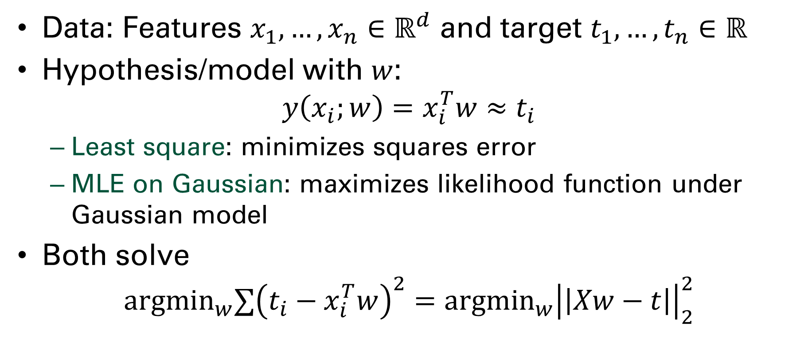
Linear regression
Data: Features $x_{1},…,x_{n}∈ℝ^{d}$ and target $t_{1},…,t_{n}∈ℝ$
Hypothesis/model with $w$: $y\left(x_{i};w\right)=x_{i}^{T}w≈t_{i}$
Least square: minimizes squares error
MLE on Gaussian: maximizes likelihood function under Gaussian model
Both solve ${argmin}_{w}∑{\left(t_{i}−x_{i}^{T}w\right)}^{2}={argmin}_{w}{\left|\left|Xw−t\right|\right|}_{2}^{2}$

Slide 4
Outline
Beyond linear regression
Bias-variance tradeoff
Regularization for linear model
Ridge
LASSO

Slide 5
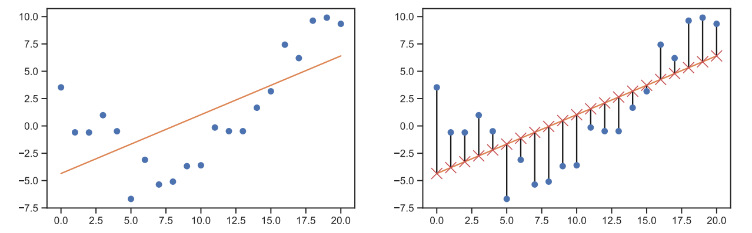

Linear models
Data: Features $x_{1},…,x_{n}∈ℝ^{d}$ and target $t_{1},…,t_{n}∈ℝ$
Hypothesis/model with $w$: $y\left(x_{i};w\right)=x_{i}^{T}w≈t_{i}$

Slide 6
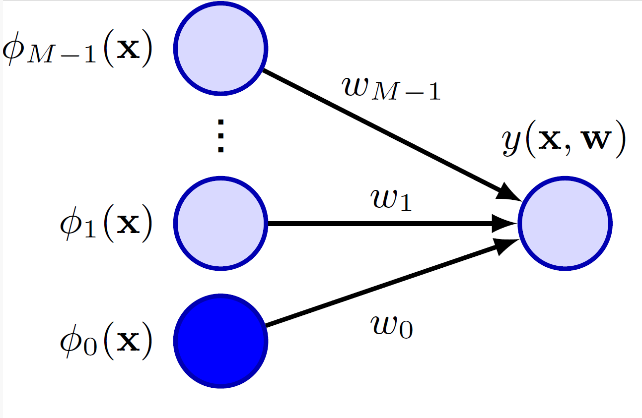
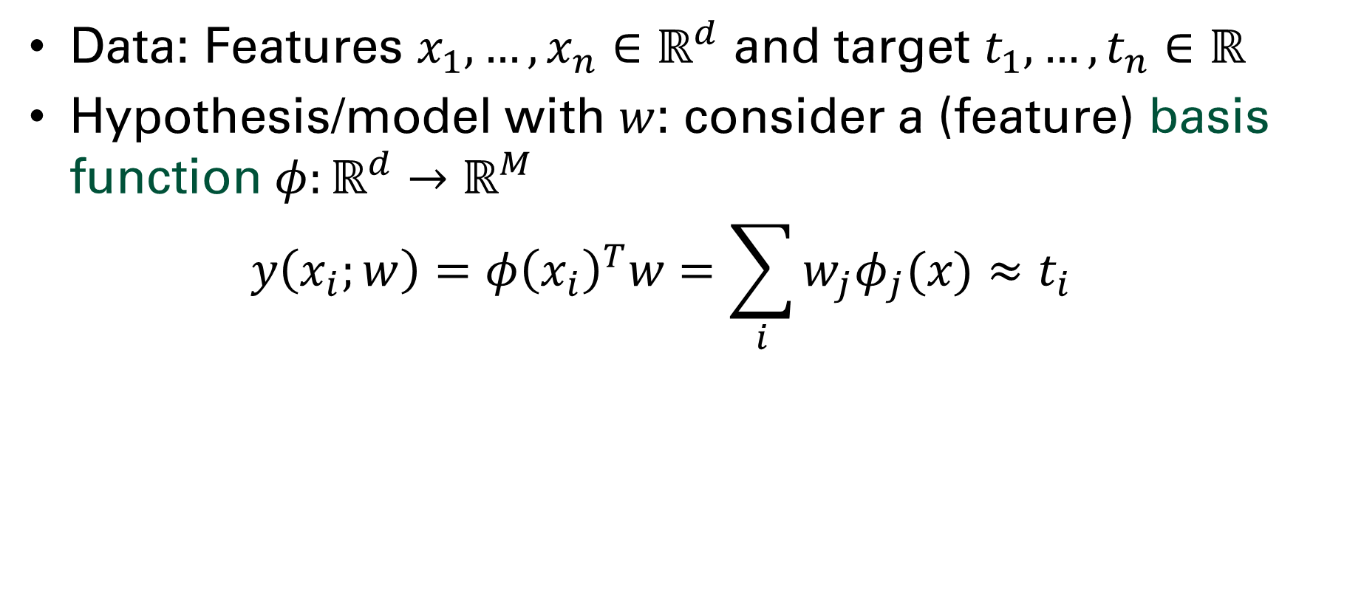
Generalized linear model
Data: Features $x_{1},…,x_{n}∈ℝ^{d}$ and target $t_{1},…,t_{n}∈ℝ$
Hypothesis/model with $w$: consider a (feature) basis function $φ:ℝ^{d}→ℝ^{M}$ $y\left(x_{i};w\right)=φ{\left(x_{i}\right)}^{T}w=\sum_{i}{w_{j}φ_{j}(x)}≈t_{i}$

Slide 7
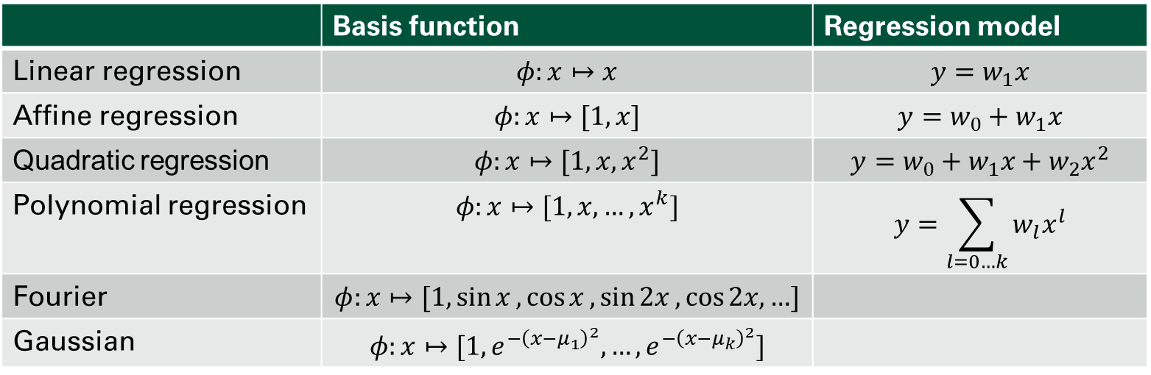

Basis function
Candidate basis function $φ:ℝ→ℝ^{M}$ $y\left(x;w\right)=φ(x)w≈t$
 | Basis function | Regression model
Linear regression | $φ:x↦x$ | $$y=w_{1}x$$
Affine regression | $φ:x↦[1, x]$ | $$y=w_{0}+w_{1}x$$
Quadratic regression | $$φ:x↦[1, x, x^{2}]$$ | $$y=w_{0}+w_{1}x+w_{2}x^{2}$$
Polynomial regression | $$φ:x↦[1, x, …,x^{k}]$$ | $$y=\sum_{l=0…k}{w_{l}x^{l}}$$
Fourier | $$φ:x↦[1,\sin{x},\cos{x},\sin{2x},\cos{2x, …}]$$
Gaussian | $$φ:x↦[1, e^{−{\left(x−μ_{1}\right)}^{2}}, …,e^{−{\left(x−μ_{k}\right)}^{2}}]$$

Slide 8
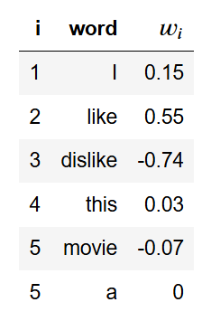
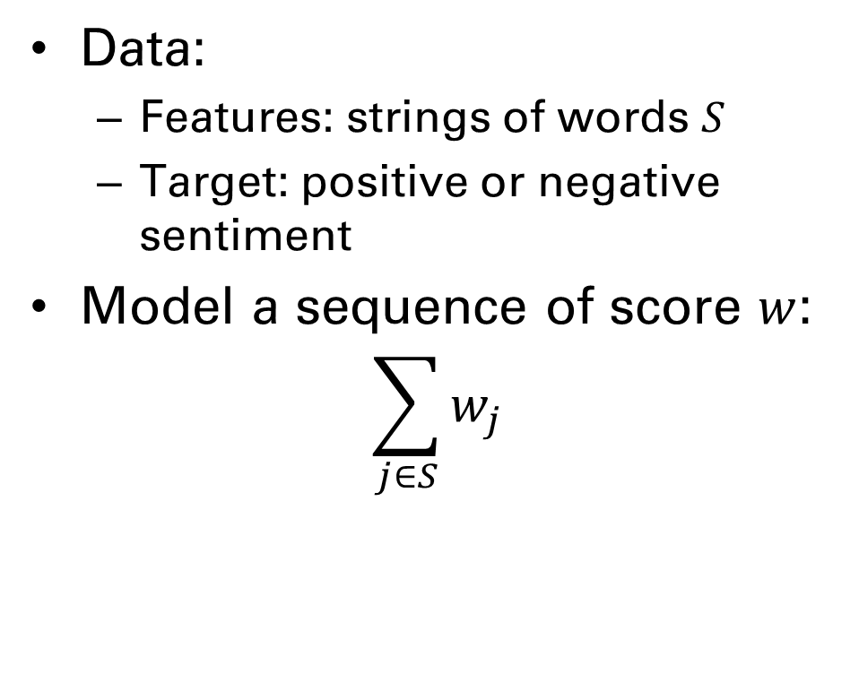
Exercise: write out the basis function
Data:
Features: strings of words $S$
Target: positive or negative sentiment
Model a sequence of score $w$: $\sum_{j∈S}{w_{j}}$

Slide 9
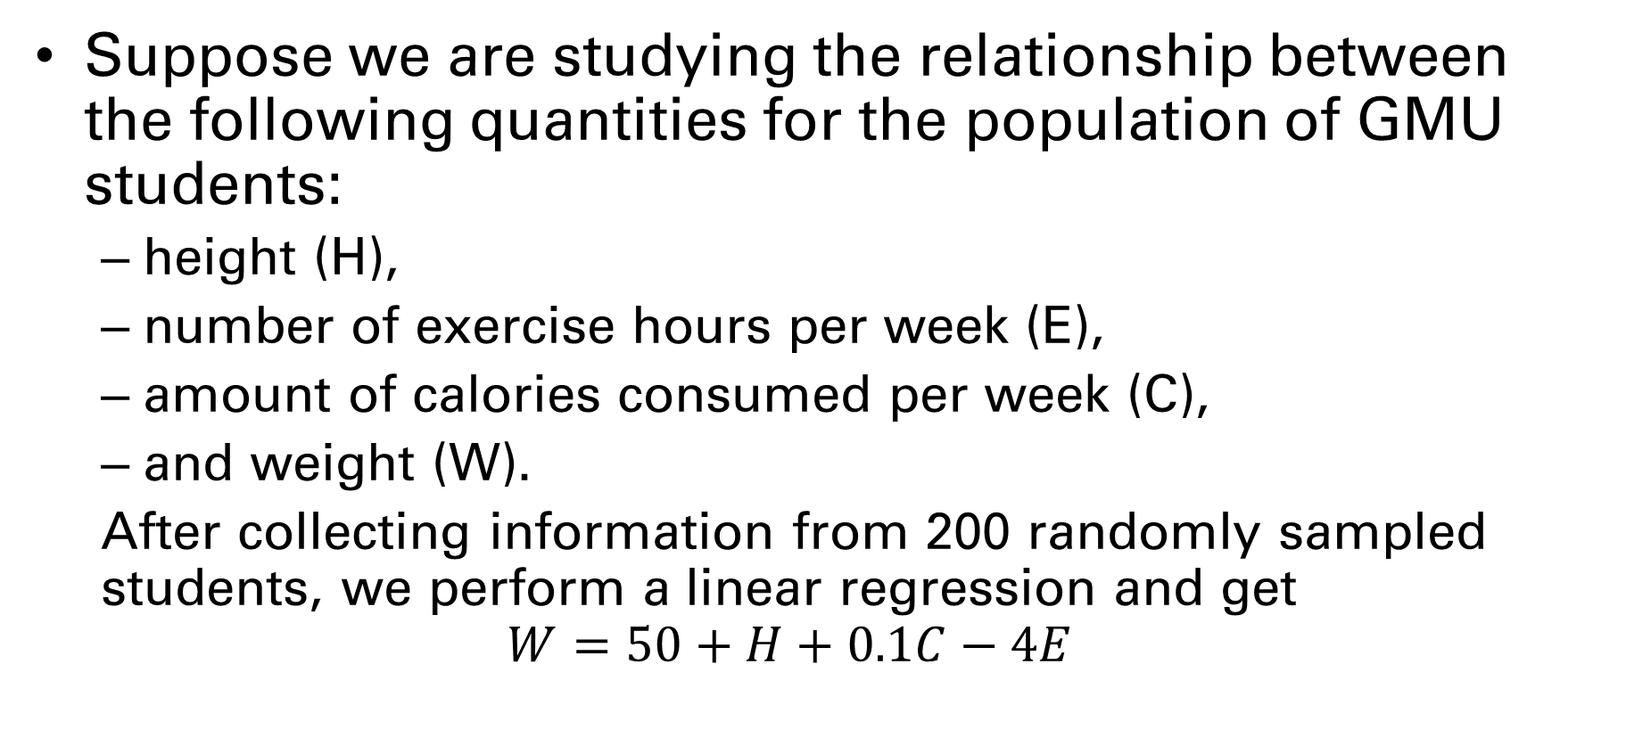
Exercise: What It Means to Learn
Suppose we are studying the relationship between the following quantities for the population of GMU students:
height (H),
number of exercise hours per week (E),
amount of calories consumed per week (C),
and weight (W).
After collecting information from 200 randomly sampled students, we perform a linear regression and get $$W=50+H+0.1C−4E$$

Slide 10
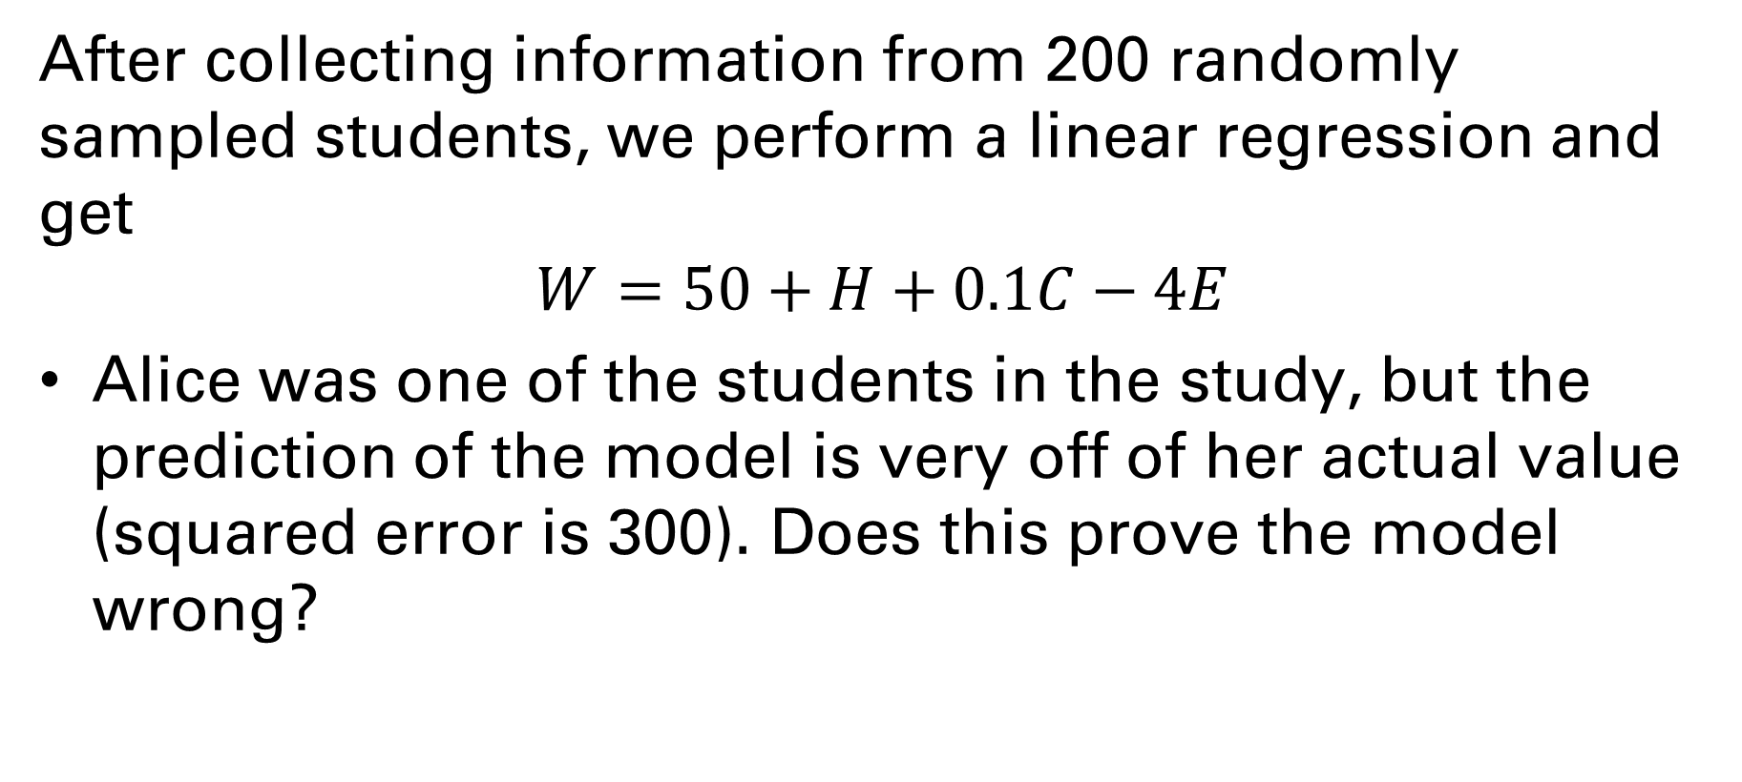
Exercise: What It Means to Learn
After collecting information from 200 randomly sampled students, we perform a linear regression and get $$W=50+H+0.1C−4E$$
Alice was one of the students in the study, but the prediction of the model is very off of her actual value (squared error is 300). Does this prove the model wrong?

Slide 11
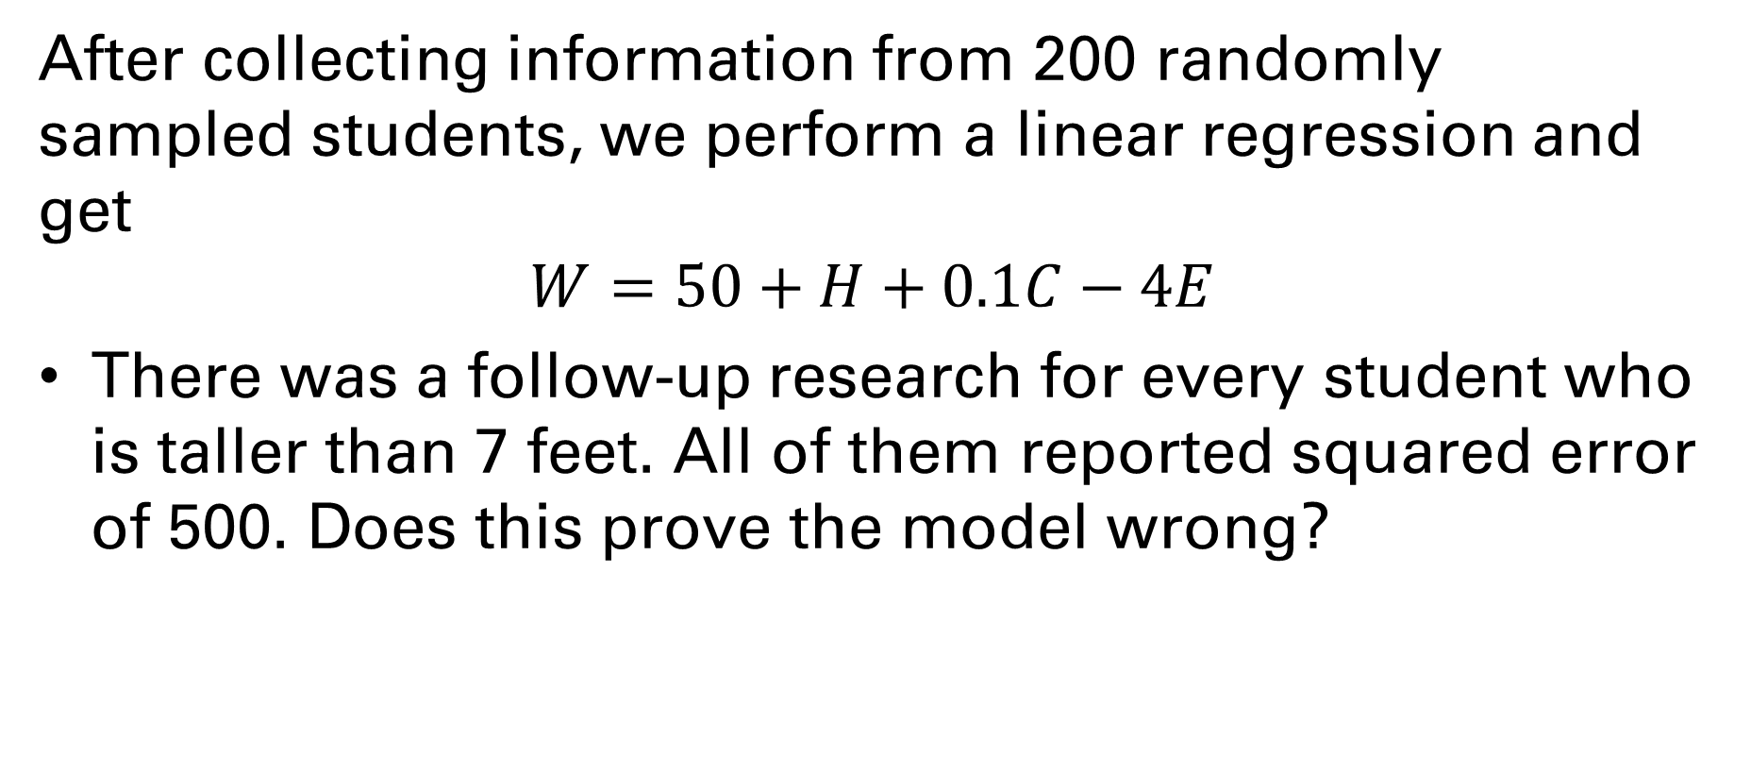
Exercise: What It Means to Learn
After collecting information from 200 randomly sampled students, we perform a linear regression and get $$W=50+H+0.1C−4E$$
There was a follow-up research for every student who is taller than 7 feet. All of them reported squared error of 500. Does this prove the model wrong?

Slide 12
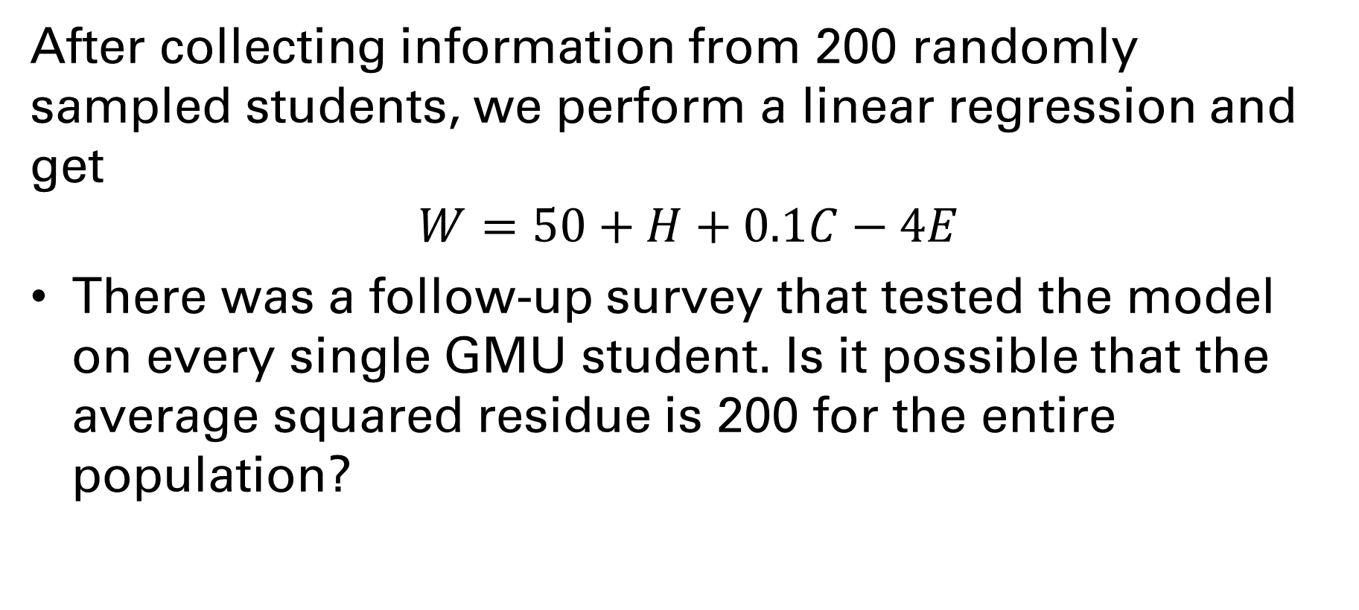
Exercise: What It Means to Learn
After collecting information from 200 randomly sampled students, we perform a linear regression and get $$W=50+H+0.1C−4E$$
There was a follow-up survey that tested the model on every single GMU student. Is it possible that the average squared residue is 200 for the entire population?

Slide 13
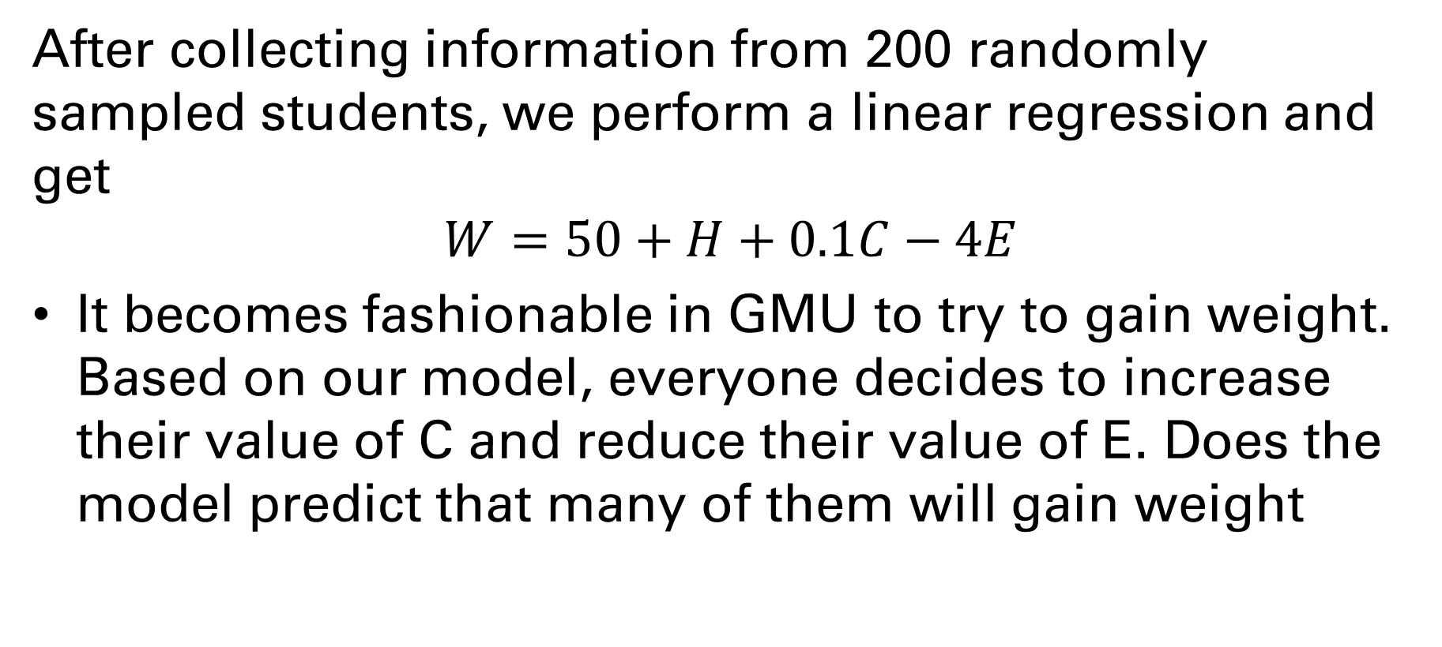
Exercise: What It Means to Learn
After collecting information from 200 randomly sampled students, we perform a linear regression and get $$W=50+H+0.1C−4E$$
It becomes fashionable in GMU to try to gain weight. Based on our model, everyone decides to increase their value of C and reduce their value of E. Does the model predict that many of them will gain weight
Notes:
No. In general, a relationship learned from a fitted model illustrates correlation and need not imply causation

Slide 14
Implications of statistical learning
Summary
Training/test data points are sampled from some distribution
The learnt relationship holds only for the distribution that the data was sampled from.
There is a small probability that the estimate using test data is off.
Implications
Results of medical studies may not apply to minority populations
Classifiers released by tech companies in the recent past were found to have high error rates on certain minority populations
Creating interactive agents is difficult

Slide 15
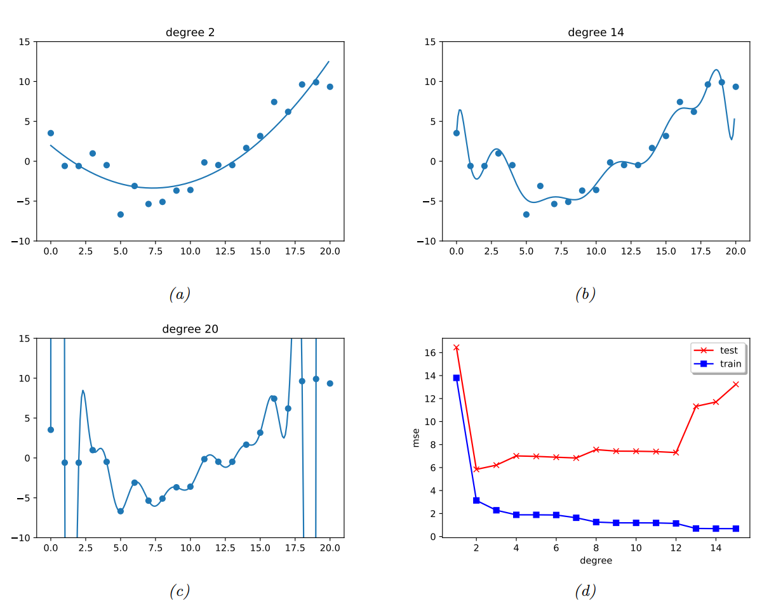
Bias-Variance Tradeoff

Slide 16
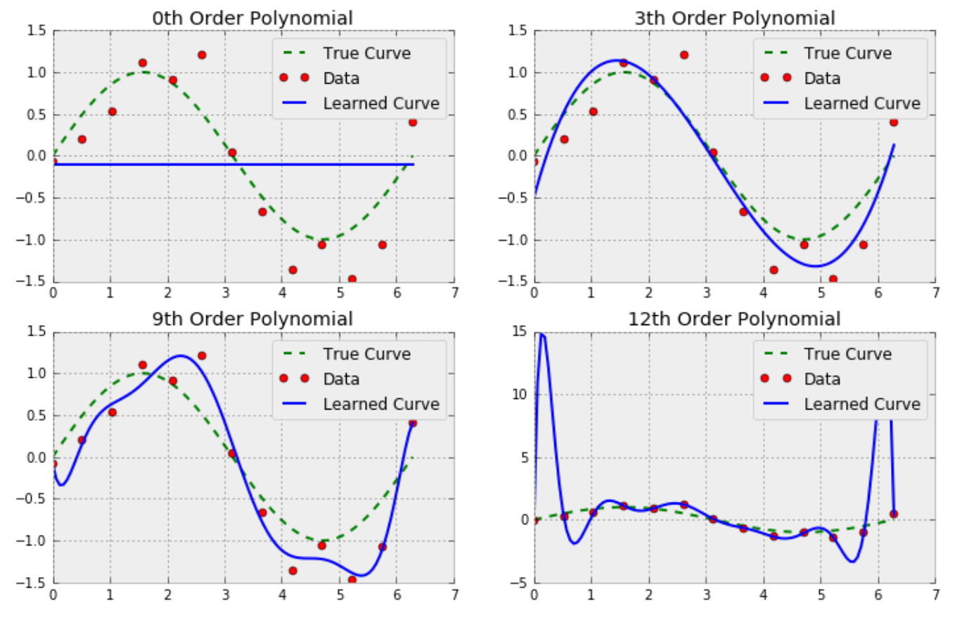
Overfitting: degree of linear regression
We should never use degree greater than 12!?
Notes:
We try to predict the true sinusoidal curve hidden in the data with polynomial degrees 0, 3, 9 and 12.
In the first plot (degree=0), we only get a horizontal line. The learned curve can neither fit the training data nor match true curve. This is called Underfitting.
In the second plot (degree=3), the predicted plot fits both data and true curve perfectly. This is a good degree for our setting.
In the third (degree=9) and fourth (degree=12) plots, as the degree increases, the traning data are fitted better but the learned curve deviates from the true curve further. This is called Overfitting.
Explanations of why degree could impact the predicted curve will come in later.

Slide 17
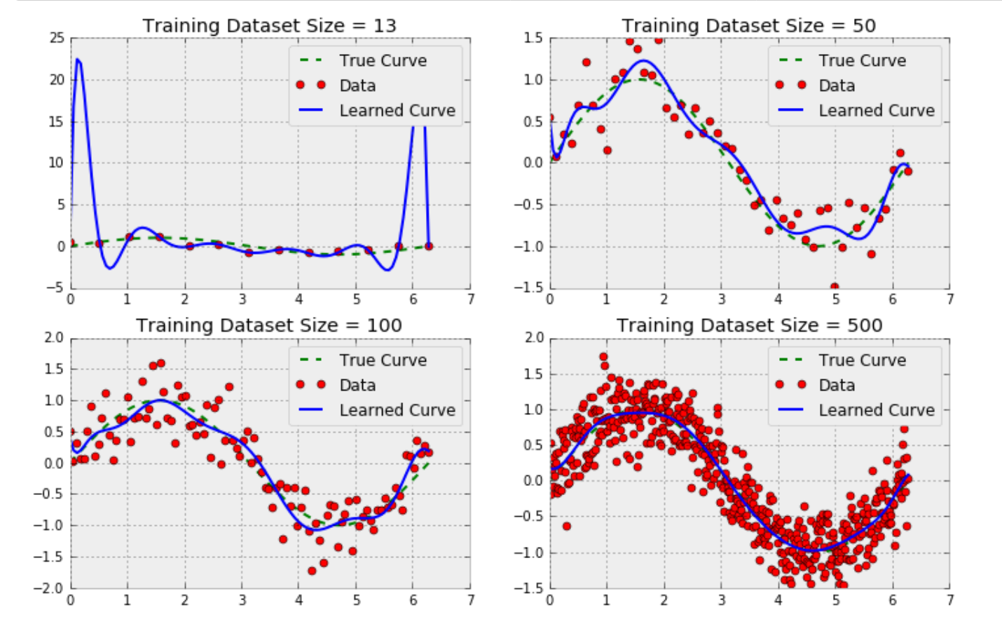
Overfitting: Dataset Size
We should never use degree greater than 12!?
Notes:
In the above plots, we try to predict the true sinusoidal curve hidden in the data with polynomial degree 12 and training dataset size 13, 50, 100 and 500.
In the first plot (size=13), overfitting occurs as we have seen just now.
Comparing the four plots altogether, we could see as the size increases, overfitting diminishes. And although more and more data points cannot be fitted by the learned curve (training error is becoming higher), but it matches the true curve better (test error will be smaller).
Explanations of why training data size impact the predicted curve will come in later.

Slide 18
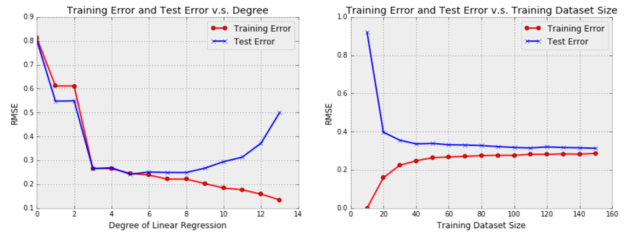
Overall Performance
Notes:
When training dataset size is small, a powerful regressor (i.e. degree is high) can fit every single sample in training dataset. Therefore, noise is also considered. This is equivalent to the ending zone of the plot (left) with respect degree.
As training dataset size increases, since the power of regressor is finite (degree is fixed), regressor starts to fail to fit every single sample. Instead it seeks to learn a curve such that samples will fall on both sides equally. Since the noise are assumed to 0 mean Gaussian noise which is symmetric with respect to 0, this is actually close to the underlying true curve.
The training error and test error will converge to 0.3 which is the variance of noise (you could check this by examining the Python code). This is not a coincidence and can be derived. We will cover this later when we study bias-variance tradeoff

Slide 19
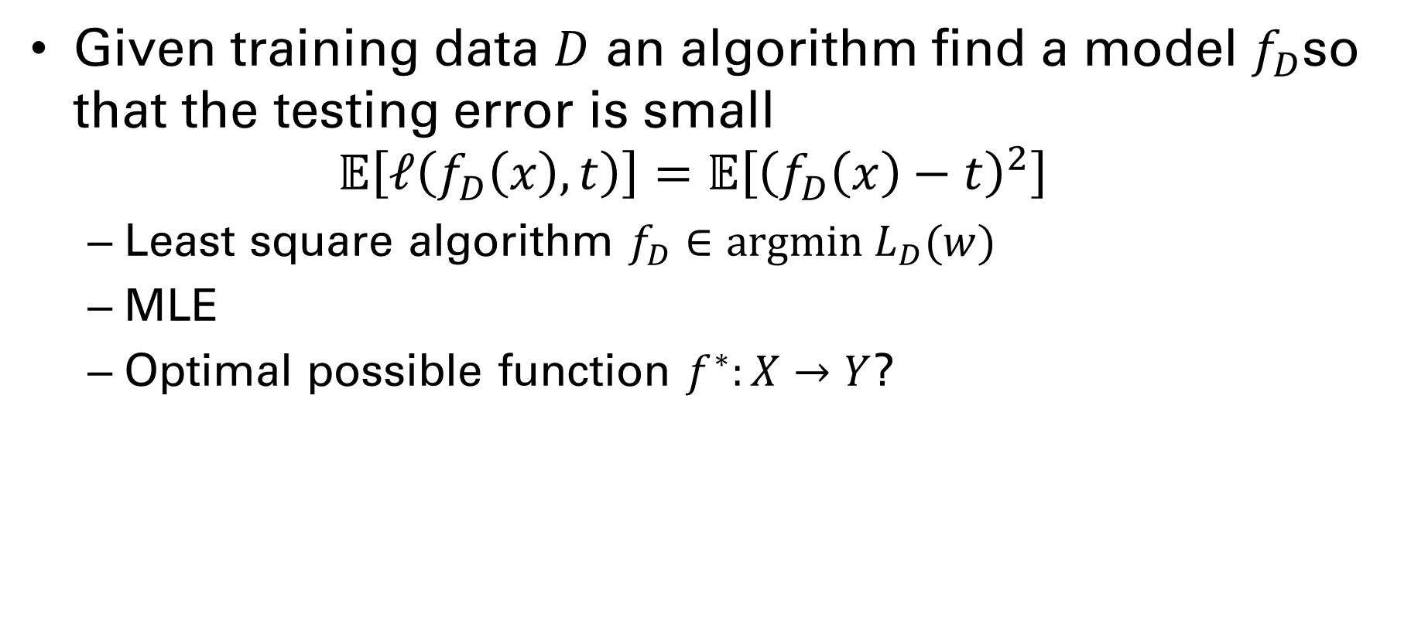
Testing and training
Given training data $D$ an algorithm find a model $f_{D}$so that the testing error is small $𝔼\left[ℓ\left(f_{D}\left(x\right), t\right)\right]=𝔼\left[{\left(f_{D}\left(x\right)−t\right)}^{2}\right]$
Least square algorithm $f_{D}∈argmin L_{D}(w)$
MLE
Optimal possible function $f^{∗}:X→Y$?

Slide 20
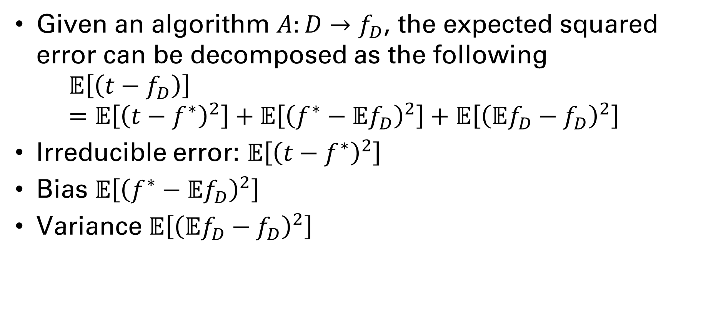
Bias-Variance Tradeoff
Given an algorithm $A:D→f_{D}$, the expected squared error can be decomposed as the following $𝔼\left[\left(t−f_{D}\right)\right]=𝔼\left[{\left(t−f^{∗}\right)}^{2}\right]+𝔼\left[{\left(f^{∗}−𝔼f_{D}\right)}^{2}\right]+𝔼\left[{\left(𝔼f_{D}−f_{D}\right)}^{2}\right]$
Irreducible error: $𝔼\left[{\left(t−f^{∗}\right)}^{2}\right]$
Bias $𝔼\left[{\left(f^{∗}−𝔼f_{D}\right)}^{2}\right]$
Variance $𝔼\left[{\left(𝔼f_{D}−f_{D}\right)}^{2}\right]$

Slide 21
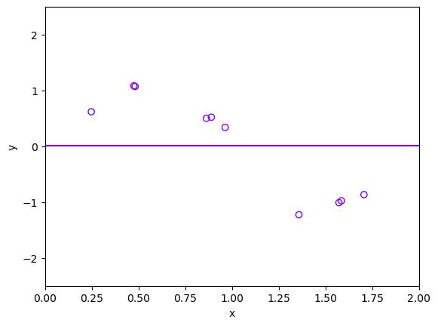
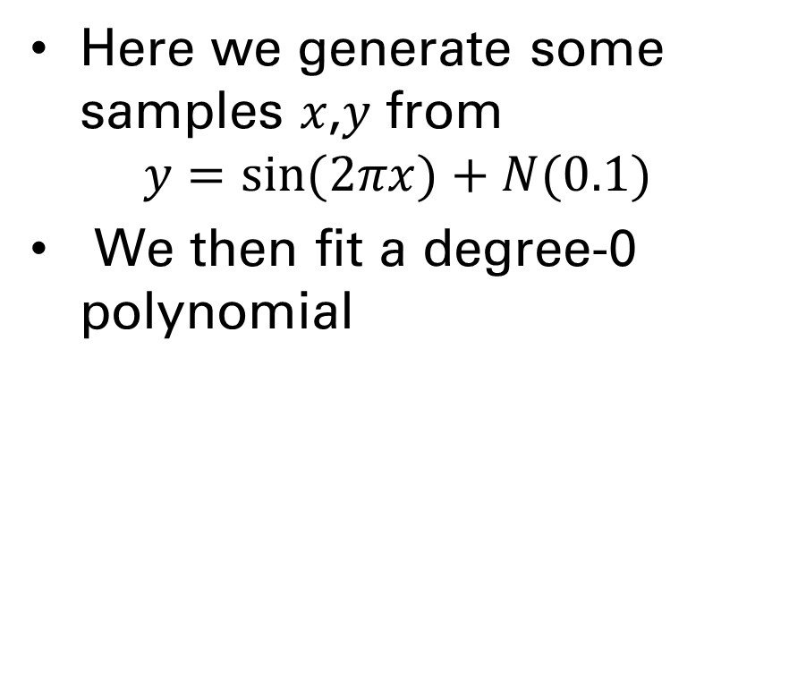
Degree 0 polynomial
Here we generate some samples 𝑥,𝑦 from $y=sin⁡(2πx)+N(0.1)$
We then fit a degree-0 polynomial

Slide 22
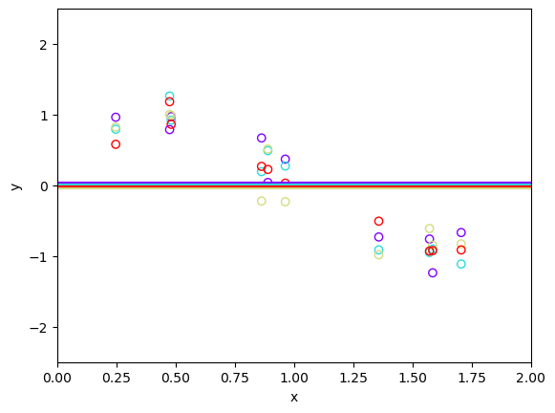
Degree 0 polynomial
Here we generate some samples 𝑥,𝑦 from $y=sin⁡(2πx)+N(0.1)$
We then fit a degree-0 polynomial

Slide 23
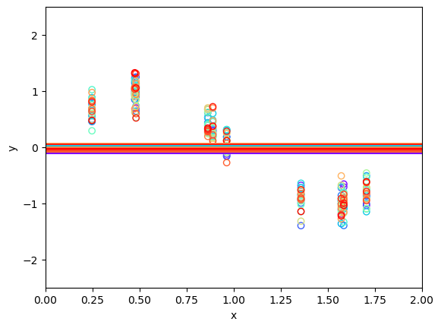
Degree 0 polynomial
Here we generate some samples 𝑥,𝑦 from $y=sin⁡(2πx)+N(0.1)$
We then fit a degree-0 polynomial

Slide 24
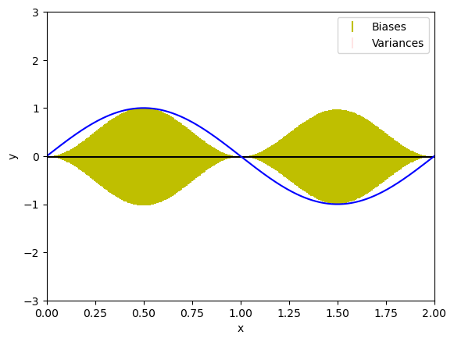
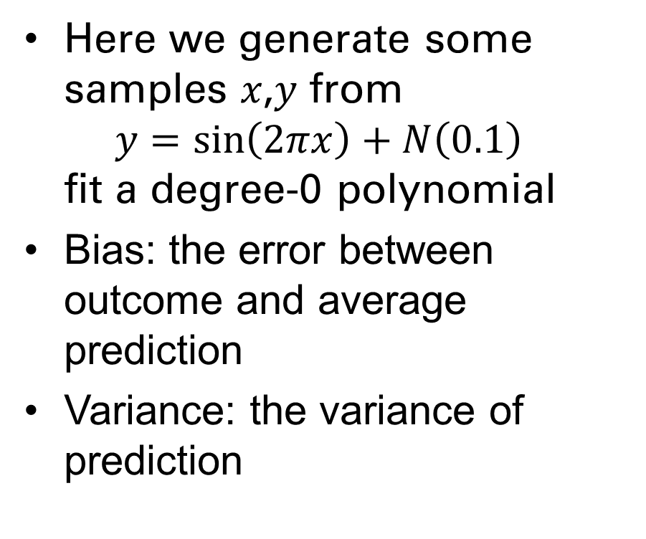
Degree 0 polynomial
Here we generate some samples 𝑥,𝑦 from $y=\sin\left(2πx\right)+N\left(0.1\right)$ fit a degree-0 polynomial
Bias: the error between outcome and average prediction
Variance: the variance of prediction

Slide 25
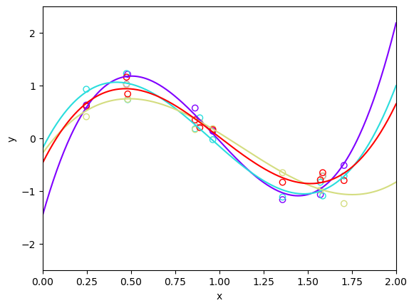
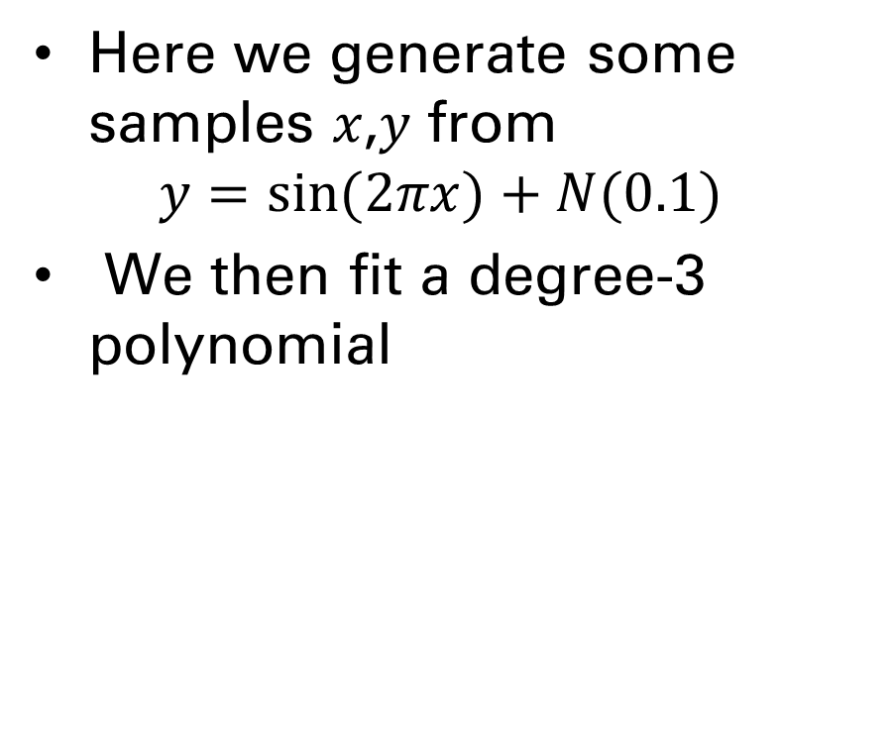
Degree 3 polynomial
Here we generate some samples 𝑥,𝑦 from $y=sin⁡(2πx)+N(0.1)$
We then fit a degree-3 polynomial

Slide 26
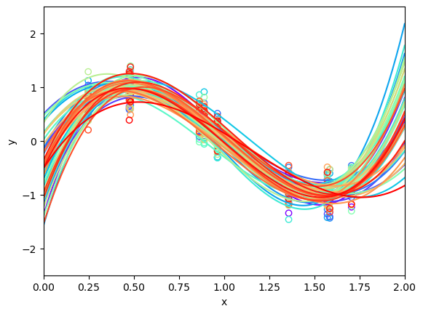
Degree 3 polynomial
Here we generate some samples 𝑥,𝑦 from $y=sin⁡(2πx)+N(0.1)$
We then fit a degree-3 polynomial

Slide 27
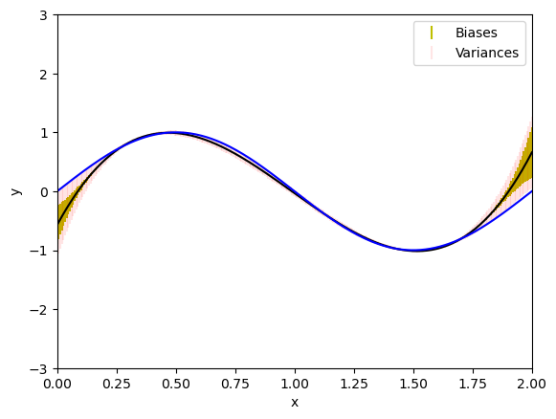
Degree 3 polynomial
Here we generate some samples 𝑥,𝑦 from $y=sin⁡(2πx)+N(0.1)$
We then fit a degree-3 polynomial

Slide 28
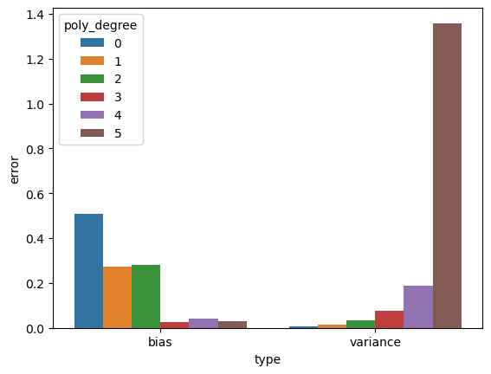
Bias and Variance for different degree sizes

Slide 29
Exercise
An expert on TV claims to have a formula to predict outcome of presidential election. It uses 31 measurements of various economic and societal quantities (inflation, divorce rate, etc). The formula correctly predicts the winner of all elections 1928-2020. Should you believe the formula’s prediction for the 2024 election?

